Slide 1

Chapter 13 :: Scripting Languages
Programming Language Pragmatics
Michael L. Scott
Copyright © 2009 Elsevier

Slide 2
What Is A Scripting Language
Modern scripting languages have two principal sets of ancestors.
  command interpreters or “shells” of traditional batch and “terminal” (command-line) computing
    IBM’s JCL, MS-DOS command interpreter, Unix sh and csh
  various tools for text processing and report generation
    IBM’s RPG, and Unix’s sed and awk.
From these evolved
  Rexx, IBM’s “Restructured Extended Executor,” which dates from 1979
  Perl, originally devised by Larry Wall in the late 1980s, and now the most widelyused general purpose scripting language.
  Other general purpose scripting languages include Tcl (“tickle”), Python, Ruby, VBScript (for Windows) and AppleScript (for the Mac)
Copyright © 2009 Elsevier

Slide 3
What Is A Scripting Language
Scripting on Microsoft platforms
  As in several other aspects of computing, Microsoft tends to rely on internally developed technology in the area of scripting languages
  Most scripting applications are based on VBScript - dialect of Visual Basic
  Microsoft has also developed a very general scripting interface (Windows Script) that is implemented uniformly by the operating system, the web server, and the Internet Explorer browser
  A Windows Script implementation of JScript, the company’s version of JavaScript, comes pre-installed on Windows machines, but languages like Perl and Python can be installed as well, and used to drive the same interface.
  Many other Microsoft applications use VBScript as an extension language, but for these the implementation framework (Visual Basic for Applications [VBA]) does not make it easy to use other languages instead
Copyright © 2009 Elsevier

Slide 4
What Is A Scripting Language
Scripting on Microsoft platforms
  Given Microsoft’s share of the desktop computing market, VBScript is one of the most widely used scripting languages
    It is almost never used on other platforms
  Perl, Tcl, Python, PHP, and others see significant use on Windows
    For server-side web scripting, PHP currently predominates: as of February 2005, some 69% of the 59 million Internet web sites surveyed by Netcraft LTD were running the open source Apache web server, and of them most of the ones with active content were using PHP
    Microsoft’s Internet Information Server (IIS) was second to Apache, with 21% of the sites, and many of those had PHP installed as well.
    For client-side scripting, where Internet Explorer controls about 70% of the browser market, most web site administrators need their content to be visible to the other 30%
    Explorer supports JavaScript (JScript), but other browsers do not support VBScript
Copyright © 2009 Elsevier

Slide 5
What Is A Scripting Language
Common Characteristics
  Both batch and interactive use
  Economy of expression
  Lack of declarations; simple scoping rules.
  Flexible dynamic typing
  Easy access to other programs
  Sophisticated pattern matching and string manipulation
  High level data types
Copyright © 2009 Elsevier

Slide 6
Problem Domains
Some general purpose languages—Scheme and Visual Basic in particular—are widely used for scripting
Conversely, some scripting languages, including Perl, Python, and Ruby, are intended by their designers for general purpose use, with features intended to support “programming in the large”
  modules, separate compilation, reflection, program development environments
For the most part, however, scripting languages tend to see their principal use in well defined problem domains
Copyright © 2009 Elsevier

Slide 7
Problem Domains
Shell Languages
  They have features designed for interactive use
  Provide a wealth of mechanisms to manipulate file names, arguments, and commands, and to glue together other programs
    Most of these features are retained by more general scripting languages
  We consider a few of them - full details can be found in the bash man page, or in various on-line tutorials:
    Filename and Variable Expansion
    Tests, Queries, and Conditions
    Pipes and Redirection
    Quoting and Expansion
    Functions
    The #! Convention
Copyright © 2009 Elsevier

Slide 8
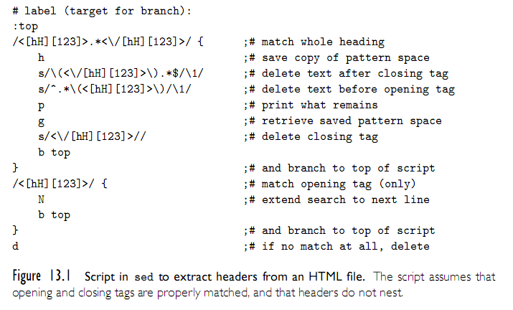
Problem Domains
Text Processing and Report Generation
  Sed
Copyright © 2009 Elsevier

Slide 9
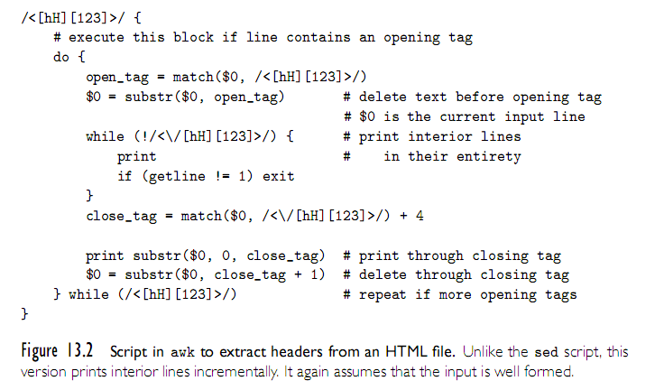
Problem Domains
Text Processing and Report Generation
  Awk
Copyright © 2009 Elsevier

Slide 10
Problem Domains
Perl
  Perl was originally developed by Larry Wall in 1987, while he was working at the NSA
  The original version was an attempt to combine sed, awk, and sh
  It was a Unix-only tool, meant primarily for text processing (the name stands for “practical extraction and report language”)
    over the years Perl has grown into a large and complex language,
  Perl is almost certainly the most popular and widely used scripting language
  It is also fast enough for much general purpose use, and includes
    separate compilation, modularization, and dynamic library mechanisms appropriate for large-scale projects
  It has been ported to almost every known operating system
Copyright © 2009 Elsevier

Slide 11
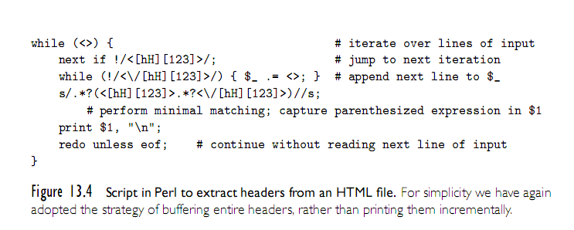
Problem Domains
Mathematics and Statistics
  APL
Copyright © 2009 Elsevier

Slide 12
Problem Domains
“Glue” Languages and General Purpose Scripting
  Perl
  Tcl
    Tcl was developed in the late 1980s at UC, Berkeley (Prof. John Ousterhout)
    Over the previous several years his group had developed a suite of VLSI design automation tools, each of which had its own idiosyncratic command language
    The initial motivation for Tcl (“tool command language”) was the desire for an extension language that could be embedded in all the tools, providing them with uniform command syntax and reducing the complexity of development and maintenance
  Tcl quickly evolved beyond its emphasis on command extension to encompass “glue” applications as well
    Ousterhout joined Sun Microsystems in 1994, where for three years he led a multiperson team devoted to Tcl development
  In comparison to Perl, Tcl is somewhat more verbose
    It makes less use of punctuation, and has fewer special cases
Copyright © 2009 Elsevier

Slide 13
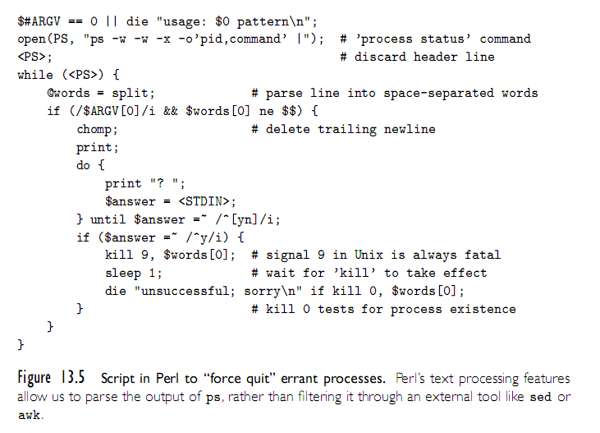
Problem Domains
Copyright © 2009 Elsevier

Slide 14
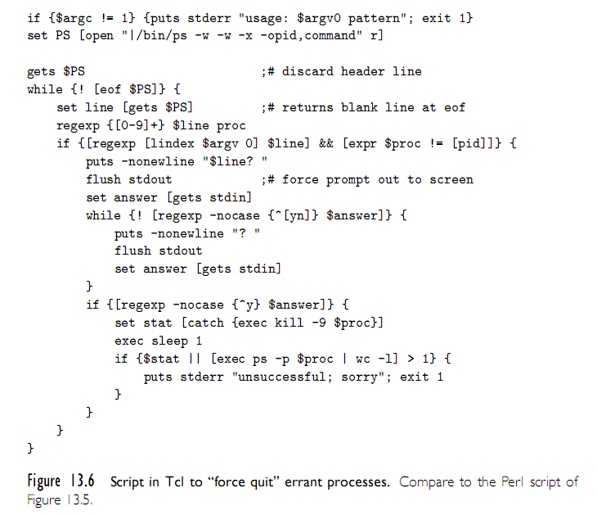
Problem Domains
Copyright © 2009 Elsevier

Slide 15
Problem Domains
“Glue” Languages and General Purpose Scripting
  As noted, Rexx is generally considered the first of the general purpose scripting languages, predating Perl and Tcl by almost a decade
  Perl and Tcl are roughly contemporaneous: both were initially developed in the late 1980s
    Perl was originally intended for glue and text processing applications
    Tcl was originally an extension language, but soon grew into glue applications
  Python was originally developed by Guido van Rossum at CWI in Amsterdam, the Netherlands, in the early 1990s
    He continued his work at CNRI in Reston, Virginia, beginning in 1995
    In 2000 the Python team moved to BeOpen.com, and to Digital Creations
    Recent versions of the language are owned by the Python Software
      All releases are Open Source.
  Ruby
    As the popularity of scripting grew in the 1990s, users were motivated to develop additional languages, to provide additional features, address the needs of specific application domains or support a style of programming
Copyright © 2009 Elsevier

Slide 16
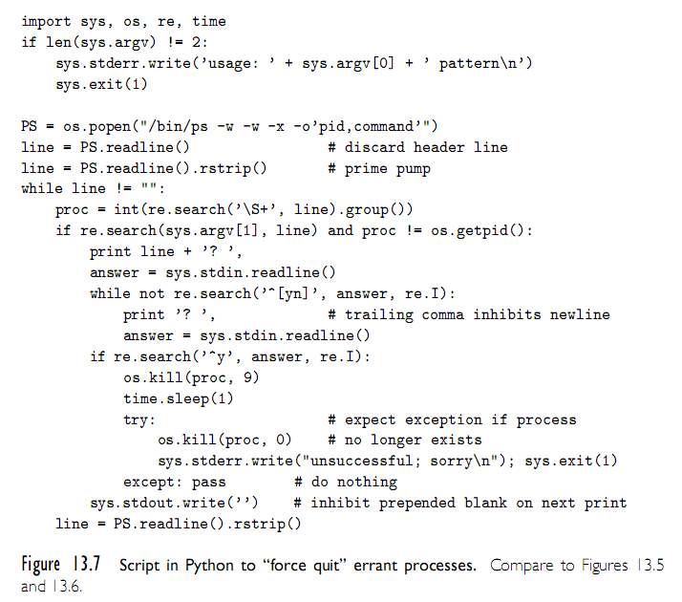
Problem Domains
Copyright © 2009 Elsevier

Slide 17
Problem Domains
Extension Languages
  Most applications accept some sort of commands
    these commands are entered textually or triggered by user interface events such as mouse clicks, menu selections, and keystrokes
    Commands in a grapical drawing program might save or load a drawing; select, insert, delete, or modify its parts; choose a line style, weight, or color; zoom or rotate the display; or modify user preferences.
  An extension language serves to increase the usefulness of an application by allowing the user to create new commands, generally using the existing commands as primitives.
  Extension languages are increasingly seen as an essential feature of sophisticated tools
    Adobe’s graphics suite (Illustrator, Photoshop, InDesign, etc.) can be extended (scripted) using JavaScript, Visual Basic (on Windows), or AppleScript
    AOLserver, an open-source web server from America On-Line, can be scripted using Tcl. Disney and Industrial Light and Magic use Python to extend their internal (proprietary) tools
Copyright © 2009 Elsevier

Slide 18
Problem Domains
Extension Languages
  To admit extension, a tool must
    incorporate, or communicate with, an interpreter for a scripting language
    provide hooks that allow scripts to call the tool’s existing commands
    allow the user to tie newly de.ned commands to user interface events
  With care, these mechanisms can be made independent of any particular scripting language
  One of the oldest existing extension mechanisms is that of the emacs text editor, used to write this book
    An enormous number of extension packages have been created for emacs; many of them are installed by default in the standard distribution.
    The extension language for emacs is a dialect of Lisp called Emacs Lisp.
    An example script appears in Figure 13.9
      It assumes that the user has used the standard marking mechanism to select a region of text
Copyright © 2009 Elsevier

Slide 19
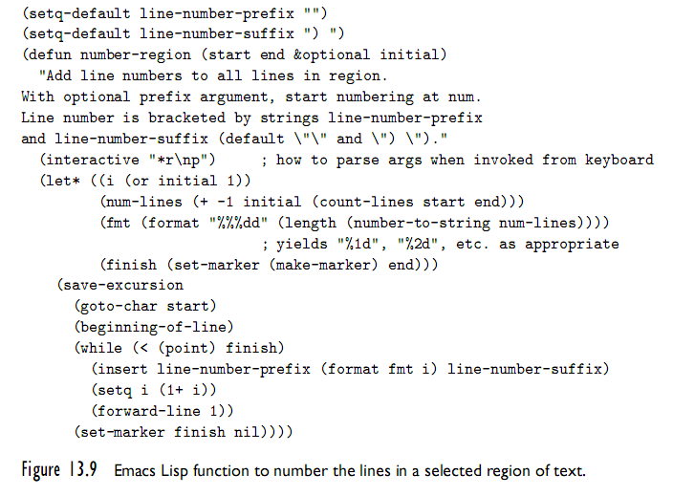
Problem Domains
Copyright © 2009 Elsevier

Slide 20
Scripting the World Wide Web
CGI Scripts
  The original mechanism for server-side web scripting is the Common Gateway Interface (CGI)
  A CGI script is an executable program residing in a special directory known to the web server program
  When a client requests the URI corresponding to such a program, the server executes the program and sends its output back to the client
    this output needs to be something that the browser will understand: typically HTML.
  CGI scripts may be written in any language available
    Perl is particularly popular:
      its string-handling and “glue” mechanisms are suited to generating HTML
      it was already widely available during the early years of the web
Copyright © 2009 Elsevier

Slide 21
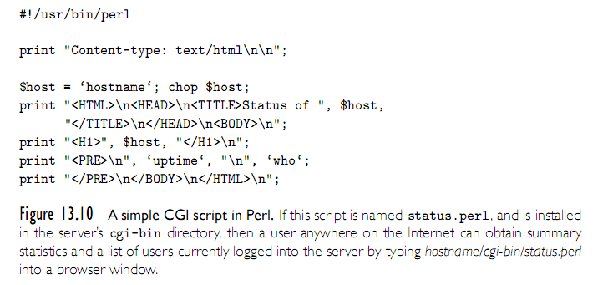
Scripting the World Wide Web
Copyright © 2009 Elsevier

Slide 22
Scripting the World Wide Web
Embedded Server-Side Scripts
  Though widely used, CGI scripts have several disadvantages:
    The web server must launch each script as a separate program, with potentially significant overhead
      Though, CGI script compiled to native code can be very fast once running
    Scripts must generally be installed in a trusted directory by trusted system administrators
      they cannot reside in arbitrary locations as ordinary pages do
    The name of the script appears in the URI, typically prefixed with the name of the trusted directory, so static and dynamic pages look different to end users
    Each script must generate not only dynamic content, but also the HTML tags that are needed to format and display it
      This extra “boilerplate” makes scripts more difficult to write
  Most web servers now provide a “module loading” mechanism that allows interpreters for one or more scripting languages
Copyright © 2009 Elsevier

Slide 23
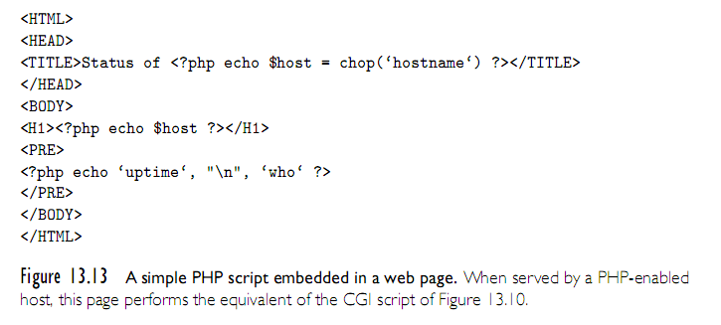
Scripting the World Wide Web
Copyright © 2009 Elsevier

Slide 24
Scripting the World Wide Web
Client-Side Scripts
  embedded server-side scripts are generally faster than CGI script, at least when startup cost predominates
    communication across the Internet is still too slow for interactive pages
  Because they run on the web designer’s site, CGI scripts and, to a lesser extent, embeddable server-side scripts can be written in many different languages
    All the client ever sees is standard HTML.
  Client-side scripts, by contrast, require an interpreter on the client’s machine
    there is a powerful incentive for convergence in client-side scripting languages: most designers want their pages to be viewable by as wide an audience as possible
While Visual Basic is widely used within speci.c organizations, where all the clients of
interest are known to run Internet Explorer, pages intended for the general public almost
always use JavaScript for interactive features.
Copyright © 2009 Elsevier

Slide 25
Scripting the World Wide Web
Client-Side Scripts
  While Visual Basic is widely used within specific organizations, where all the clients of interest are known to run Internet Explorer, pages intended for the general public almost always use JavaScript for interactive features
Java Applets
  An applet is a program designed to run inside some other program
  The term is most often used for Java programs that display their output in (a portion of) a web page
  To support he execution of applets, most modern browsers contain a Java virtual machine
Copyright © 2009 Elsevier

Slide 26
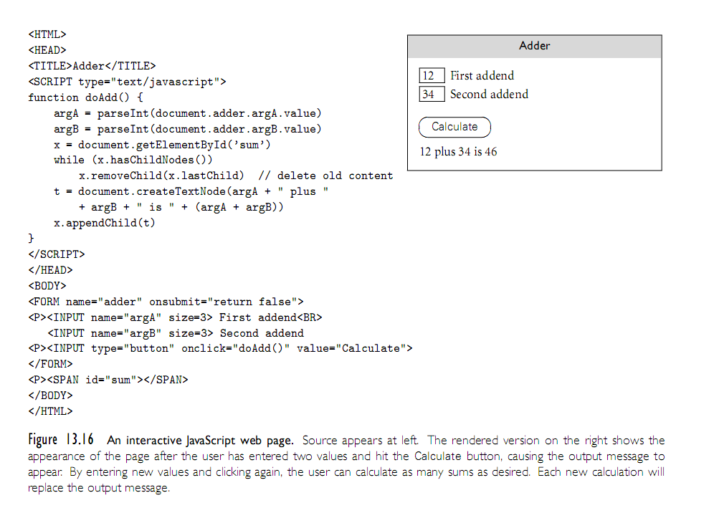
Scripting the World Wide Web
Copyright © 2009 Elsevier

Slide 27
Innovative Features
Earlier we listed several common characteristics of scripting languages – see text for more details:
  both batch and interactive use
  economy of expression
  lack of declarations; simple scoping rules
  flexible dynamic typing
  easy access to other programs
  sophisticated pattern matching and string manipulation
  high level data types
Copyright © 2009 Elsevier

Slide 28
Innovative Features
Most scripting languages (Scheme is the obvious exception) do not require variables to be declared
Perl and JavaScript, permit optional declarations - sort of compiler-checked documentation
Perl can be run in a mode (use strict ’vars’) that requires declarations
  With or without declarations, most scripting languages use dynamic typing
The interpreter can perform type checking at run time, or coerce values when appropriate
Tcl is unusual in that all values—even lists—are represented internally as strings
Copyright © 2009 Elsevier

Slide 29
Innovative Features
Nesting and scoping conventions vary quite a bit
  Scheme, Python, JavaScript provide the classic combination of nested subroutines and static (lexical) scope
  Tcl allows subroutines to nest, but uses dynamic scope
  Named subroutines (methods) do not nest in PHP or Ruby
    Perl and Ruby join Scheme, Python, JavaScript, in providing firstclass anonymous local subroutines
  Nested blocks are statically scoped in Perl
    In Ruby they are part of the named scope in which they appear
  Scheme, Perl, Python provide for variables captured in closures
  PHP and the major glue languages (Perl, Tcl, Python, Ruby) all have sophisticated namespace
    mechanisms for information hiding and the selective import of names from separate modules
Copyright © 2009 Elsevier

Slide 30
Innovative Features
String and Pattern Manipulation
  Regular expressions are present in many scripting languages and related tools employ extended versions of the notation
    extended regular expressions in sed (Figure 13.1) awk (Figures 13.2 and 13.3), Perl (Figures 13.4 and 13.5), Tcl (Figure 13.6), Python (Figure 13.7), and Ruby (Figure 13.8)
    grep, the stand-alone Unix is a pattern-matching tool
  Two main groups.
    The first group includes awk, egrep (the most widely used of several different versions of grep), the regex routines of the C standard library, and older versions of Tcl
      These implement REs as defined in the POSIX standard
    Languages in the second group follow the lead of Perl, which provides a large set of extensions, sometimes referred to as “advanced REs”
Copyright © 2009 Elsevier

Slide 31
Innovative Features
Data Types
  As we have seen, scripting languages don’t generally require (or even permit) the declaration of types for variables
  Most perform extensive run-time checks to make sure that values are never used in inappropriate ways
  Some languages (e.g., Scheme, Python, and Ruby) are relatively strict about this checking
    When the programmer who wants to convert from one type to another must say so explicitly
  Perl (and likewise Rexx and Tcl) takes the position that programmers should check for the errors they care about
    in the absence of such checks the program should do something reasonable
Copyright © 2009 Elsevier

Slide 32
Innovative Features
Object Orientation
  Perl 5 has features that allow one to program in an object-oriented style
  PHP and JavaScript have cleaner, more conventional-looking object-oriented features
    both allow the programmer to use a more traditional imperative style
  Python and Ruby are explicitly and uniformly object-oriented
  Perl uses a value model for variables; objects are always accessed via pointers
  In PHP and JavaScript, a variable can hold either a value of a primitive type or a reference to an object of composite type.
    In contrast to Perl, however, these languages provide no way to speak of the reference itself, only the object to which it refers
Copyright © 2009 Elsevier

Slide 33
Innovative Features
Object Orientation (2)
  Python and Ruby use a uniform reference model
  Classes are themselves objects in Python and Ruby, much as they are in Smalltalk
  They are types in PHP, much as they are in C++, Java, or C#
  Classes in Perl are simply an alternative way of looking at packages (namespaces)
  JavaScript, remarkably, has objects but no classes
    its inheritance is based on a concept known as prototypes
  While Perl’s mechanisms su.ce to create object-oriented programs, dynamic lookup makes
  Both PHP and JavaScript are more explicitly object oriented
Copyright © 2009 Elsevier

